Slide 1
PROJECT ADVSNTAGES AND DISADVANTAGES OF AETING UNHEALTHY
CERVINI MARTÍN
VAQUE DE MARINIS OCTAVIO 1ro . A

Slide 2
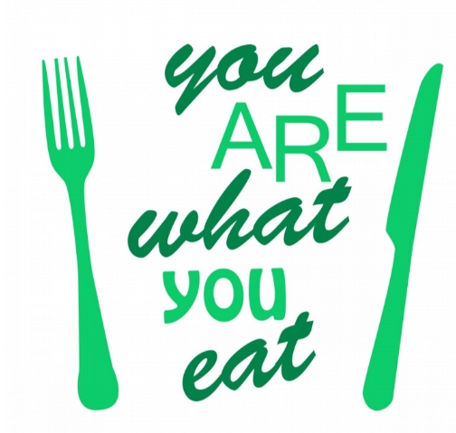
You are what You eat
IT MEANS THAT TO BE FIT AND HEALTHY YOU NEED TO EAT GOOD FOOD.
EATING ISN’T JUST ABOUT SATISFYING HUNGER, YOU HAVE TO PROVIDE NUTRIENTS TO YOYR BODY.

Slide 3
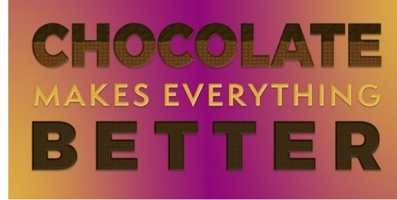
Chocolate makes every thing beteer
THERE IS CONSIDERABLE EVIDENCE THAT COCOA CAN PROVIDE POWERFUL HEALTY BENEFITS BEING SPECIALLY PROTECTIVE AGAINST HEART DISEASE.
IT IS IMPORTANT TO SAY THAT IT IS NOT GOOD IN LARGE QUANTITY TOU CAN EAT A SMALL PIECE EVERY DAY

Slide 4
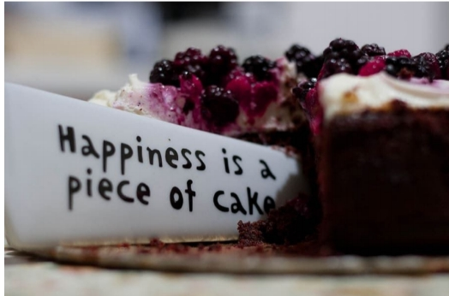
HAPPINESS IS FOUND WHEN YOU SHARE WITH YOR LOVED ONES.
EATING IS AN ACTION YOU OFTEN DO WITH OTHERS AND A CAKE IS A THING YOU SHARE WITH YOUR FAMILY AND FRIENDS.
HAPPINESS IS FOUND WHEN YOU SHARE WITH YOUR LOVED ONES.

