Slide 1
The Advantages and Disadvantages of Eating Healthy.

Slide 2
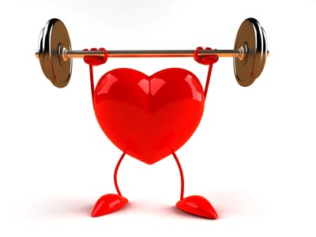
advantage
The advantages of a healthy life are as follows:

Slide 3
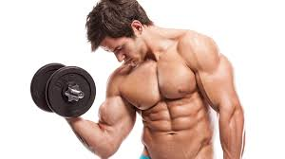

It keeps you strong.

Slide 4
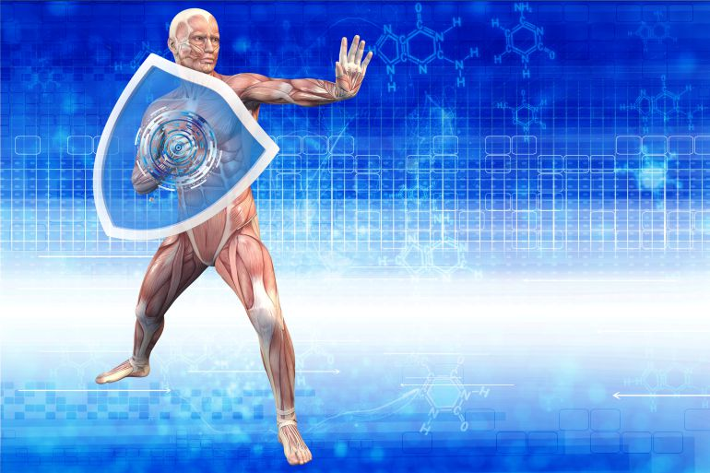
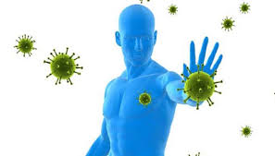
Protect your immune system.

Slide 5

Keeps the skin healthy.

Slide 6
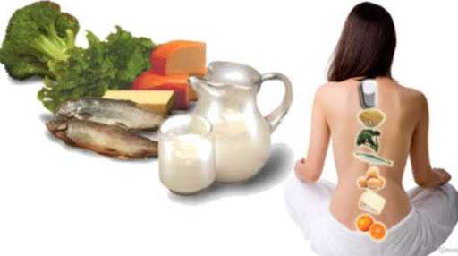
It prevents osteoporosis.

Slide 7
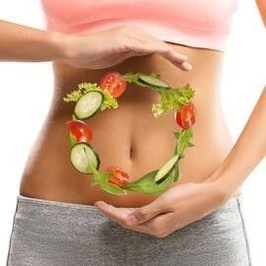
Regulates intestinal transit.

Slide 8

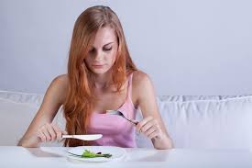
disadvantages
The disadvantages of eating are as follows:

Slide 9
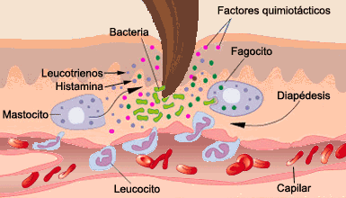
Inflammation.

Slide 10
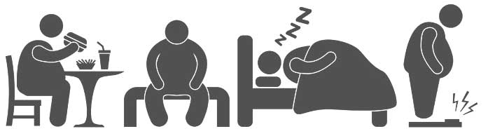
Sedentary.

Slide 11
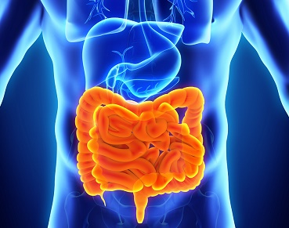
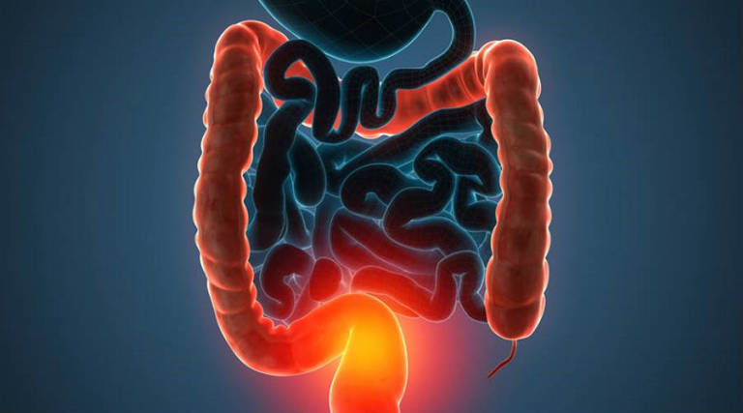
Stomach intestinal problems.

Slide 12
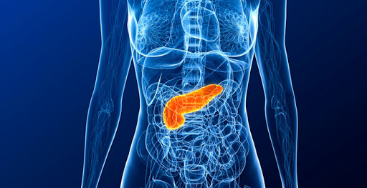
Diabetes.

Slide 13
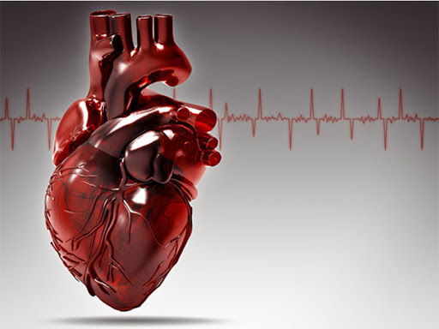
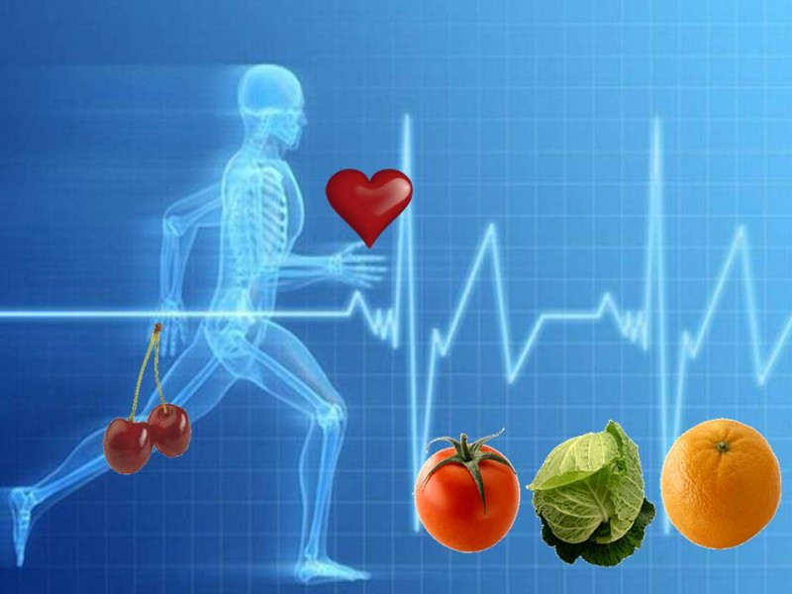
Cardiovascular diseases.

